Slide 1

Transparent and Immutable Taxing System Using Blockchain

Slide 2





Problems with Current Tax System
1. Lack of transparency
Why “Where’s My Tax!” ??
Indian Taxation System has not been experimented from its inception. Since, “Experimenting is the mother of knowledge” .Experimenting the Indian taxation will be insightful as well as exciting one..
2. No Real time data sharing
3.Lack of Traceability

Slide 3




Why Blockchain ??
(Why Blockchain in taxation system)
1.Transparent
Blockchain provides provenance, traceability and transparency of transactions
3. Real time sharing:
When information is updated, it’s updated for everyone in the network at the same time
2.Security
The digital ledger cannot be altered or tampered with once the data is entered. Fraud is less likely and easier to spot
4.Tracebility
When an information is updated in the ledger. The data becomes traceable throughout the network
Hence, Blockchain can disrupt Indian taxation system.
3
Notes:
3

Slide 4

Our Idea!!
Blockchain is an ideal technology which could disrupt the Indian Tax System by overcoming all the roadblocks previously mentioned. Our idea includes the following features:
(i) Tracking where and when tax has been paid, and in doing so reduce tax fraud .
(ii) Helping multinational companies provide a consistent data set for multiple tax authorities
(iii) Adds value within a business, between businesses & between businesses and governments
(iv) Giving tax authorities and other regulators more confidence in the data supplied to them.
(v)Giving more visibility to micro transactions such as those done by individuals as part of the sharing economy.
In addition, this system also features an user friendly interface which enables every citizen of the country to potentially know how his contributed tax has been put in use .
Notes:
4

Slide 5



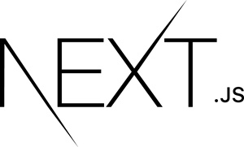

Tech Stack
NPM
React JS / Next JS
Smart Contract
Package manager for using third party tools in our application.
Complex UI / UX management
Server Side Rendering
Ethereum
Blockchain based distributed computing platform and operating system featuring smart contract functionality.
5

Slide 6
Our System’s Architecture
1.Amount
2.Payee ID
3.Type of Tax
4.Time Stamp
5.Tax Category
6.Tax Head Code
BLOCK 1 HEADER
Hash of previous block header
Credit
Transaction Object
1.Amount
2.Time Stamp
3.GST no.
4.PIN code
5.Locality
6.Area
Debit
Block 1 transactions
6

Slide 7
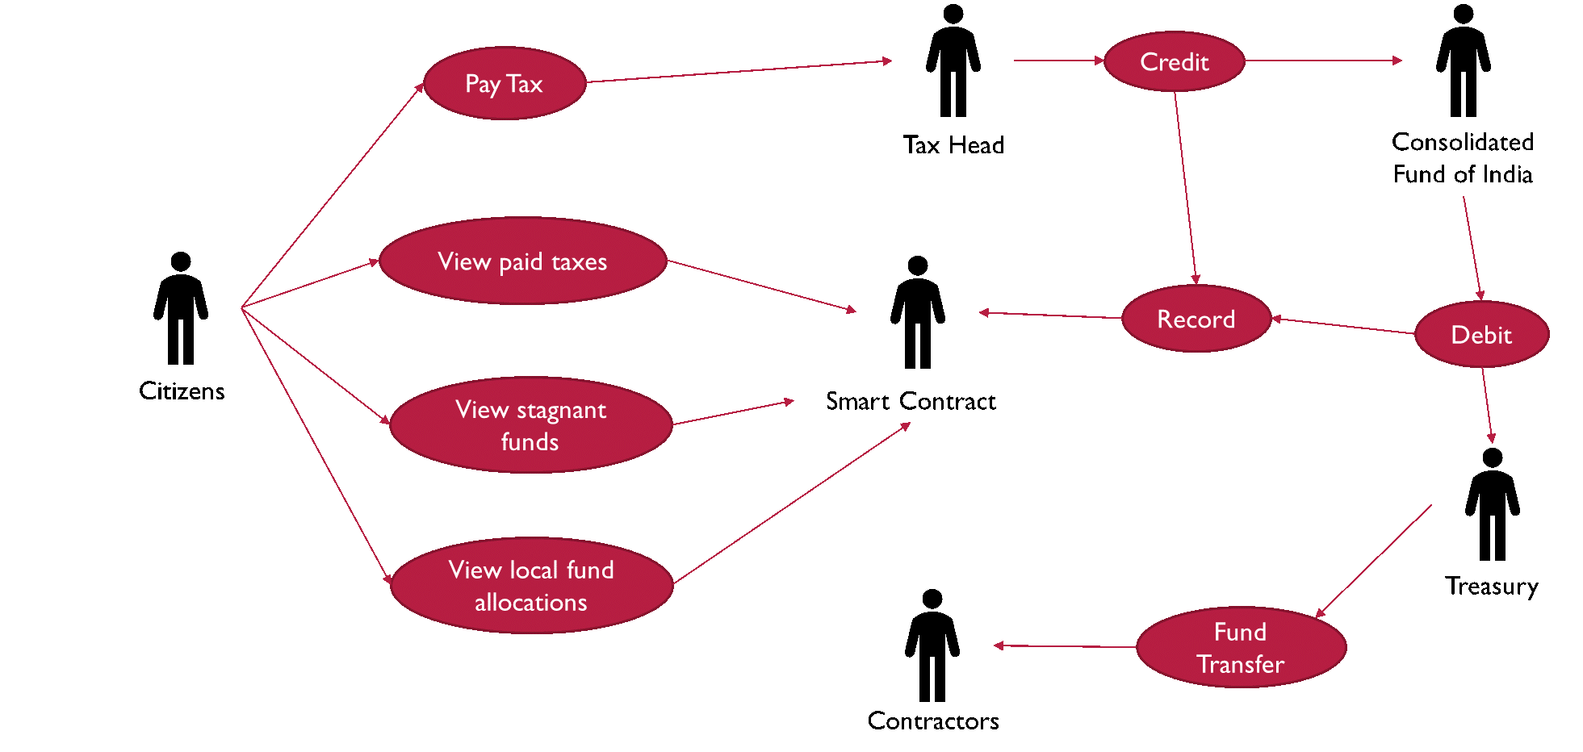
USE CASE of Proposed System
The proposed system consists of a Smart reporting Module which is one of the key module of this proposed system. The main functionality of this module is to report the citizens about their paid taxes and able to view the stagnant and allocated funds. Since, entire information about taxes are entered into permissioned blockchain, the reliability of the information is guaranteed.

Slide 8

Bonus Incentive of this System!!!!
RTI(Right To Information) gets enhanced..

Slide 9
Thank You

